Slide 1
Youtube Viral Predictor
Presented by Group 11
Rainey Chak Jonh Solo Suofei Feng Yen-Ming Huang

Slide 2
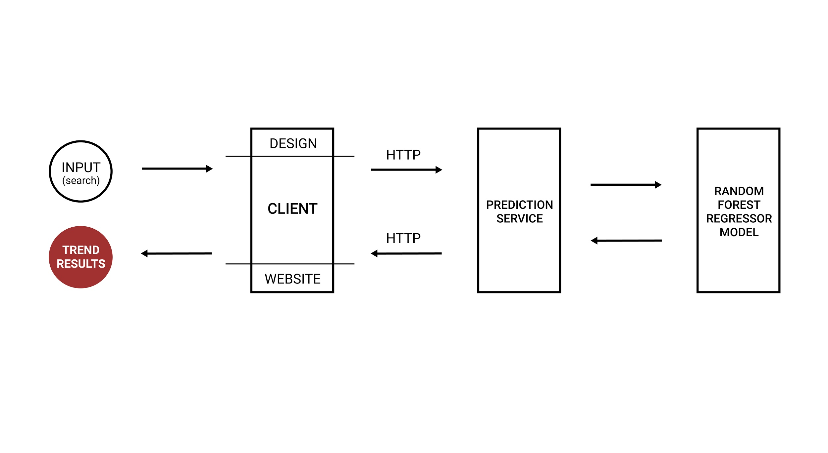
Overview

Slide 3
Individual contribution
Build the responsive website to present the trending prediction to the user
Filtering the youtube api dataset for user easier to target metrics they are looking for
The website provides favorite list, key metrics and other functionalities
The website is implemented by HTML, CSS and JavaScript

Slide 4
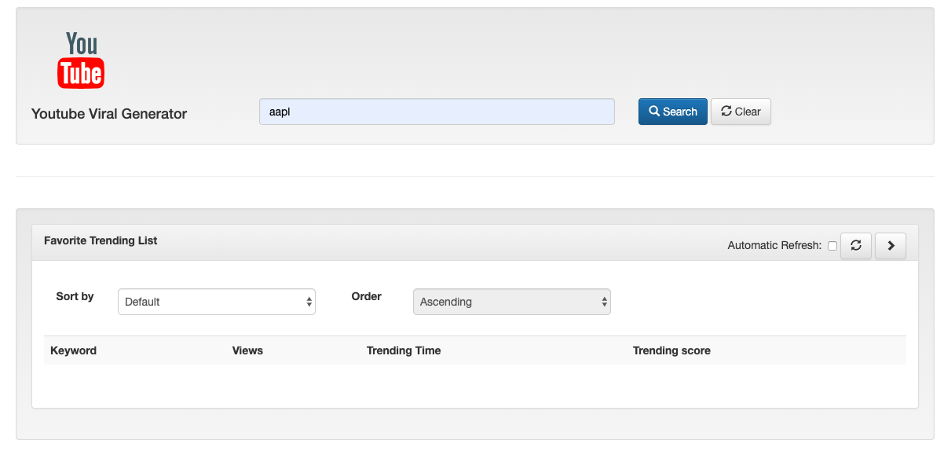
Demo

Slide 5
Next Steps
Predict how long a video will take to trend
Sort through different categories
Expand to more than just English

